Slide 1
MULTI STAGE DESIGN
Properties for identifying objects
Object | Instance ID | Instance Name | Class ID | Class Name
Stage | ID | Name | - | -
Subset | - | xxx@ | ID | Name
Process | - | xxx@ | ID | Name
Work | ID | Name | - | -
Kanban | ID | Name | - | -
Location | - | - | - | -
Variable | - | Name | - | -
Template | ID | Name

Slide 2
MULTI STAGE DESIGN
Loation FullPath Rule
JitObject (Name) → instance reference name
FullPath
<instance>\<instance name>@<class name>
<parent instance>\<child class>
instance name can be omitted if not conflict
Stage(st) \st
Subset(SS1)→a \st\a@SS1
Subset(SS1)→b
\st\b@SS1
Subset(SS2)
\st\a@SS1\SS2
Process(P1) \st\a@SS1\SS2\P1
Process(P2) \st\a@SS1\SS2\P2
Subset(SS2) \st\b@SS1\SS2
Process(P1) \st\b@SS1\SS2\P1
Process(P2) \st\b@SS1\SS2\P2
Process(P3)
\st\a@SS1\P3
Process(P3) \st\b@SS1\P3

Slide 3
MULTI STAGE DESIGN
MultiStageTest . Test006
Stage：st
Subset：Y
Subset：X→x1
Subset：Z→z1
Subset：Z→z2
Subset：X→x2
Process
C
Process
A
Process
B
Process
D
Process
D
Process
A
Process
B
Process
E
s=1m
d=1m
s=1m
d=1m
s=1m
d=1m
s=1m
d=1m
s=1m
d=1m
s=1m
d=1m
s=1m
d=1m
s=1m
d=1m

Slide 4
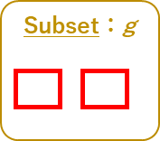
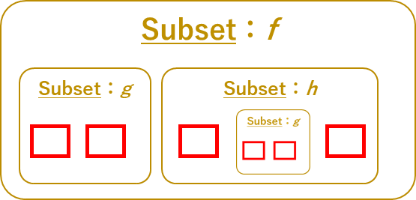
MULTI STAGE DESIGN
Legend ID name
Stage：st
Default Push Link
JitProcessPriorityJoint
a
Subset：X
Process
z
Process
x
Process
y
Process
a
Process
b
x→..\a
y→..\a
a→z
Subset：f
ProcsAdd()
ProcsRemove()
FindProcess()
Add/RemoveWorkInReserve()
GetWorkInReserve()
Enter/ExitWorkToProcess()
GetWorks()
Add/GetProcessLinks()
DI
ClassModel
Subset：h
Subset：g
Stage : st
X:aaa
X:bbb
X:ccc
a
b
c
a
b
a
b
Stage：e
w1
aaa → c
c → bbb
bbb\b→ccc\b
not supported
deep link
a → b
a → b
a → b

Slide 5
Subset tree <Subset.Name>:<tree# in Stage>
e:1
f:2
f:6
g:7
g:3
h:4
g:5
h:8
g:9
Stage：e
0
1
12
2
5
x
11
13
16
3
4
7
18
a
b
c
a
b
d
a
b
c
a
b
d
6
8
9
10
14
15
17
19
20
21
Parent Table
e:1 n/a
f:2 e:1
f:6 e:1
g:3 f:2
g:5 h:4
g:7 f:6
g:9 h:8
h:4 f:2
h:8 f:6

Slide 6
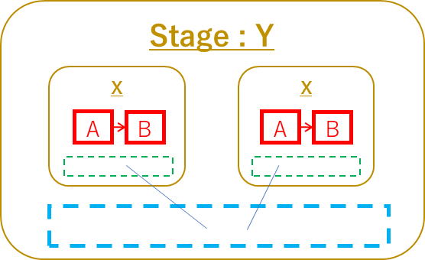
MULTI STAGE DESIGN
Default Push Link
StageSubset：X
Process
A
Process
B
EnterProcess＝A
ExitProcess＝B
ProcsAdd()
ProcsRemove()
FindProcess()
Add/RemoveWorkInReserve()
GetWorkInReserve()
Enter/ExitWorkToProcess()
GetWorks()
Add/GetProcessLinks()
DI
ClassModel
Stage : Y
Stage : Z
X
X
X
A
B
A
B
A
B
DoNext()
Events
Now
SendKanban

